Slide 1
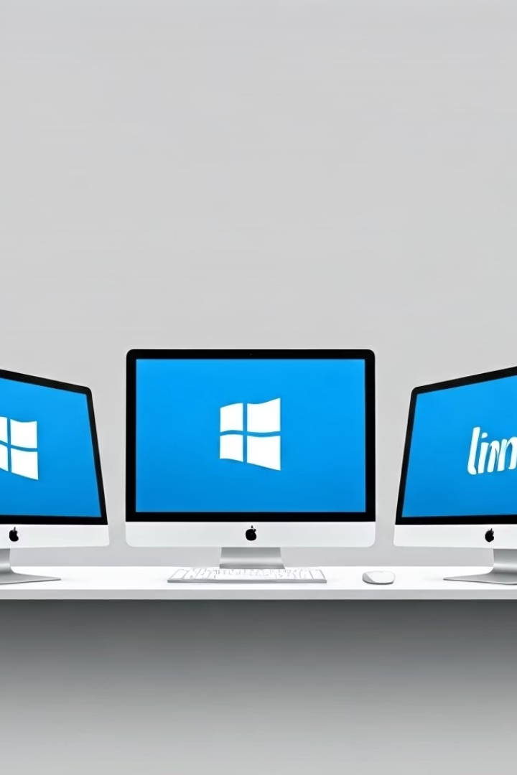

What is an Operating System?
An operating system (OS) is the main software that runs your computer. It controls how everything works, from opening apps to connecting to the internet, save files, and more.
The three most common operating systems are:
Windows (by Microsoft)
macOS (by Apple)
Linux (open-source and free)
by Ram N Java

Slide 2
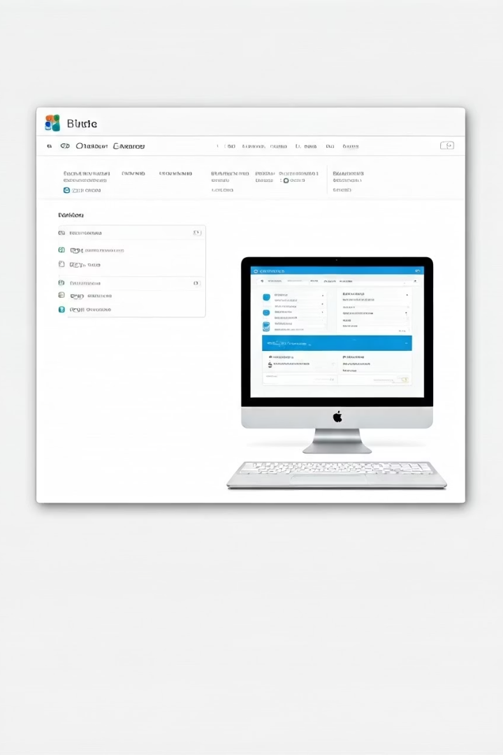
Ease of Use
Windows
macOS
Is easy to use and very common. Most people have used it before.
Has a clean and modern design. It's simple but only works on Apple computers.
Linux
Can be a bit harder for beginners, but some versions like Ubuntu are easier to learn.

Slide 3
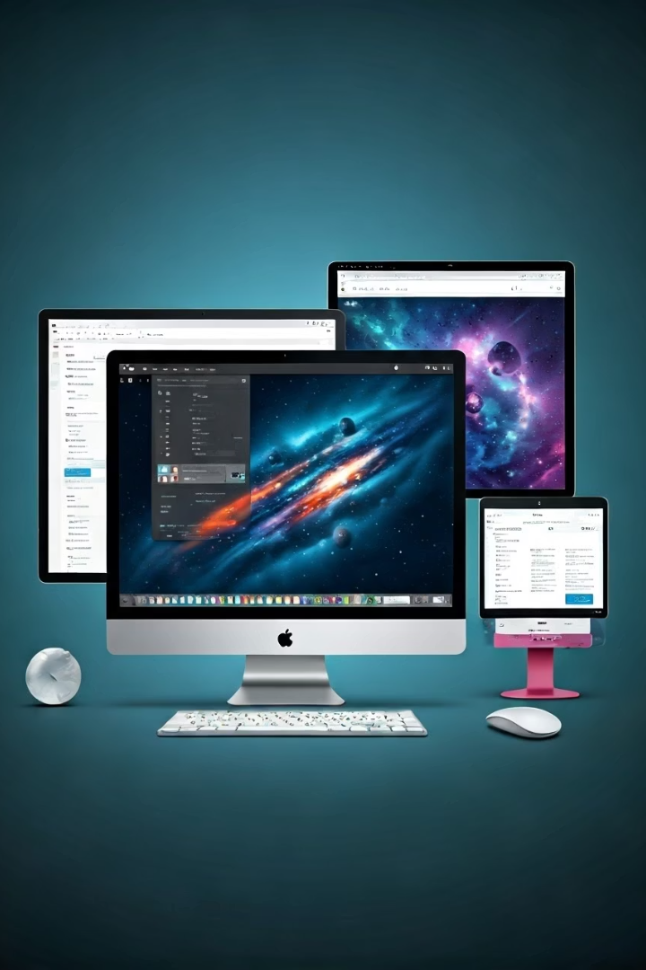



Software and Apps
Windows
macOS
Linux
Works with most programs and games. It is good for school, work, and fun.
Is great for creative work like editing videos or making music.
Has many free apps, but some popular programs may not work without extra steps.

Slide 4




Security
Windows
macOS
Can get viruses, but using antivirus software helps protect it.
Is more secure because it's harder for viruses to attack.
Linux
Is very safe and not many viruses target it.

Slide 5






Customization
Linux
Gives you full control
Windows
Lets you change some things
macOS
Does not allow much change
Windows lets you change some things, like your wallpaper and colors.
macOS does not allow much change. It keeps things simple and stable.
Linux gives you full control. You can change almost everything if you want.

Slide 6
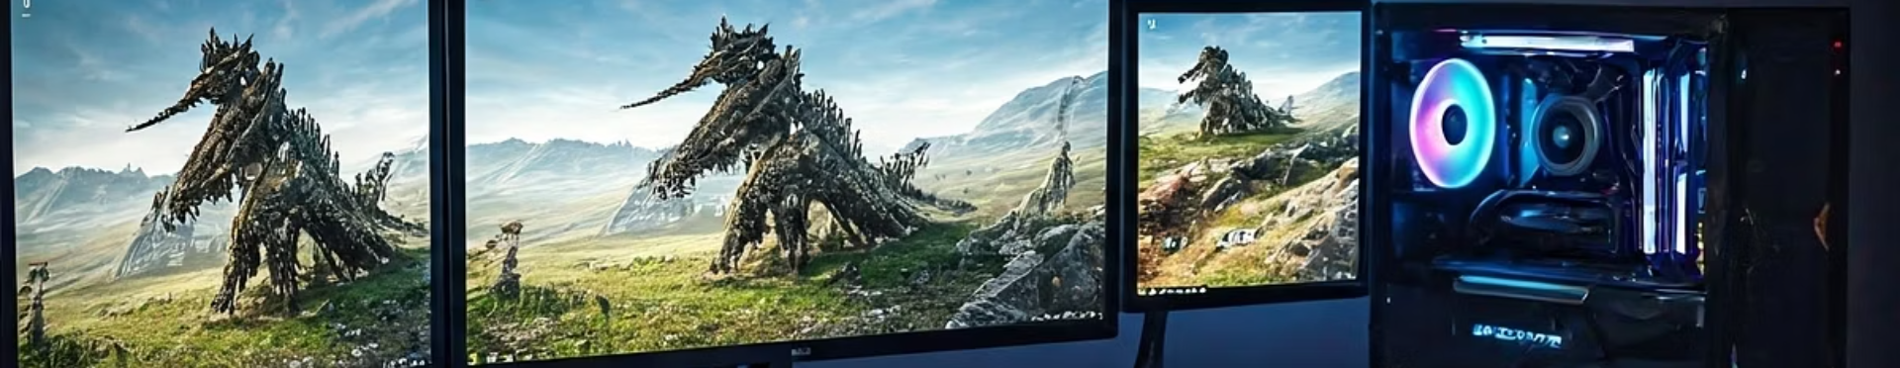
Gaming
1
Windows
2
macOS
3
Linux
Is the best for gaming.
Most games are made for it.
Can run some games, but not many.
Is getting better for games, but it may take more setup.

Slide 7
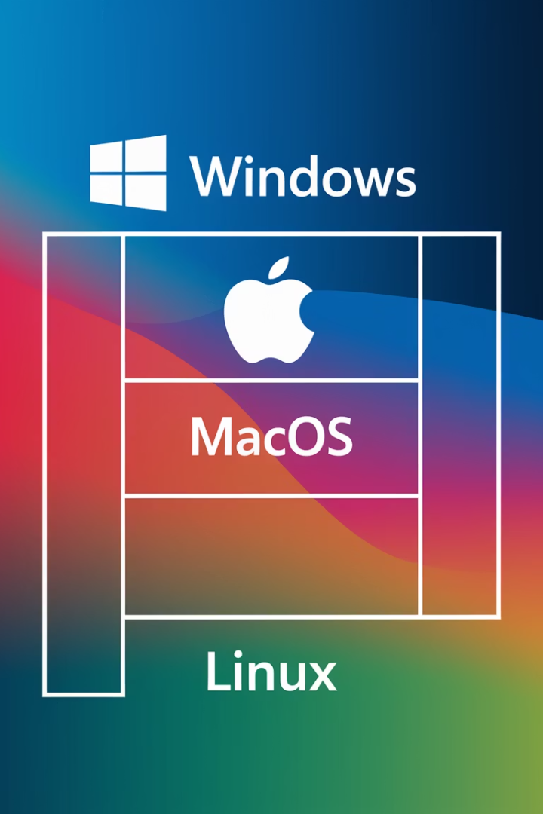
Cost
Windows
macOS
Linux
Windows usually comes pre-installed on most laptops. If not, you have to buy a license.
macOS is free, but you need to buy an Apple computer, which is expensive.
Linux is completely free and works on old or new computers.

Slide 8
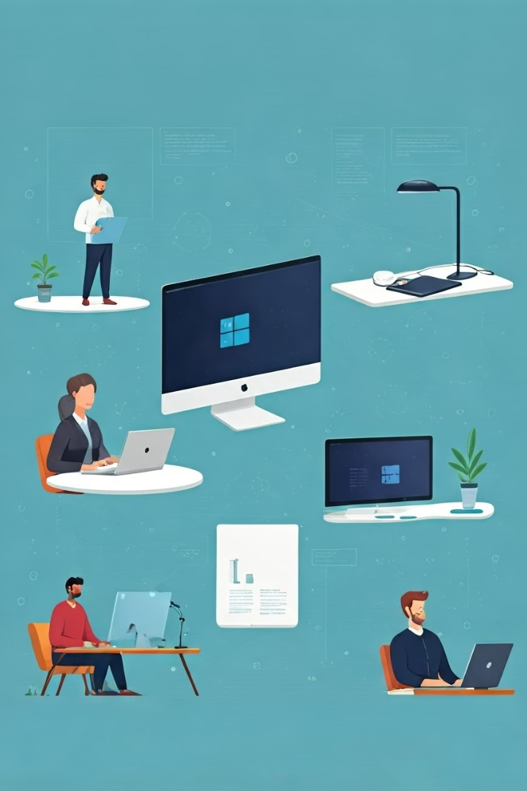



Who Should Use What?
Windows
Choose if you want something easy and works with most programs.
macOS
Choose if you use Apple products and do creative work.
Linux
Choose if you want something free, secure, and customizable, or if you're interested in learning more about computers.

Slide 9

Final Tip for Beginners
Making Your Choice
Learning More
Consider your needs, budget, and how much you want to customize your experience.
Starting Out
If you're curious and like to explore, Linux is a great way to learn.
If you're just starting out and want something simple, Windows or macOS is best.

